Slide 1
Security Risk Assessment Vulnerability & Control
Julian Talbot & Konrad Buczynski www.juliantalbot.com www.sectara.com

Slide 2
Threat Pathway
CONTROLS
CONTROLS
Threat
Intent
Capability
Vulnerability
Asset
Exposure
Criticality
Consequence
Objectives

Slide 3
Vulnerability (Apple™ Dictionary)
the quality or state of being exposed to the possibility of being attacked or harmed, either physically or emotionally:
conservation authorities have realized the vulnerability of the local population
he is confined in isolation because of his vulnerability to infection|

Slide 4
Vulnerability Security Risk Management Body of Knowledge (SRMBOK) Talbot, Julian & Jakeman, Miles Wiley, NY, USA.
A weakness that can be exploited by an adversary to gain access to an asset.
Vulnerabilities might include, but are not limited to, building characteristics, personal behaviors, properties of equipment, and security practices and procedures.
An exploitable weakness or deficiency of an asset (facility, entity, system, information, person) that can create “windows of opportunity,” which could:
Allow a threat to materialize
Increase the likelihood of attack
Increase the consequence of an attack

Slide 5
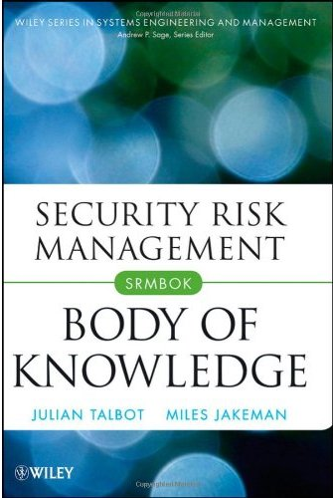
Vulnerability (SRMBOK)
﻿Degree of susceptibility and resilience to hazards.
A multidimensional concept that involves exposure, sensitivity, and resilience.
Can increase through cumulative events or when multiple stresses weaken the ability of a person, organization, or community to buffer itself against future adverse events.

Slide 6
Vulnerability (SRMBOK)
﻿Include the conditions determined by political, economic, social, technical, or legal factors and processes, which increase the susceptibility of an organization or community to the impact of hazards.
May affect the likelihood and/or consequences of an attack.
Comprises resilience and susceptibility.
Resilience is related to existing controls and the capacity to reduce or sustain harm.
Susceptibility is related to exposure.

Slide 7
Examples of Vulnerabilities
In an ICT environment might include access points to the internet. Failure caused by design flaws or incorrect firewall configuration could for example lead to successful hacking, i.e., increased consequence.
Financial difficulties constitute vulnerability in an individual and might increase the likelihood of an attempt to compromise information that they have access to.
Physical vulnerability might include ground floor windows without security treatments.
Associated risks might include theft from break in, which would be more likely to occur and more likely to succeed if windows have no security treatments.
In this example, consequence remains unchanged—the consequence of a break and enter will be no greater or lesser whether the offender enters by a window, door, roof, or other means.

Slide 8
ISO31000 Risk Management - Process

Slide 10
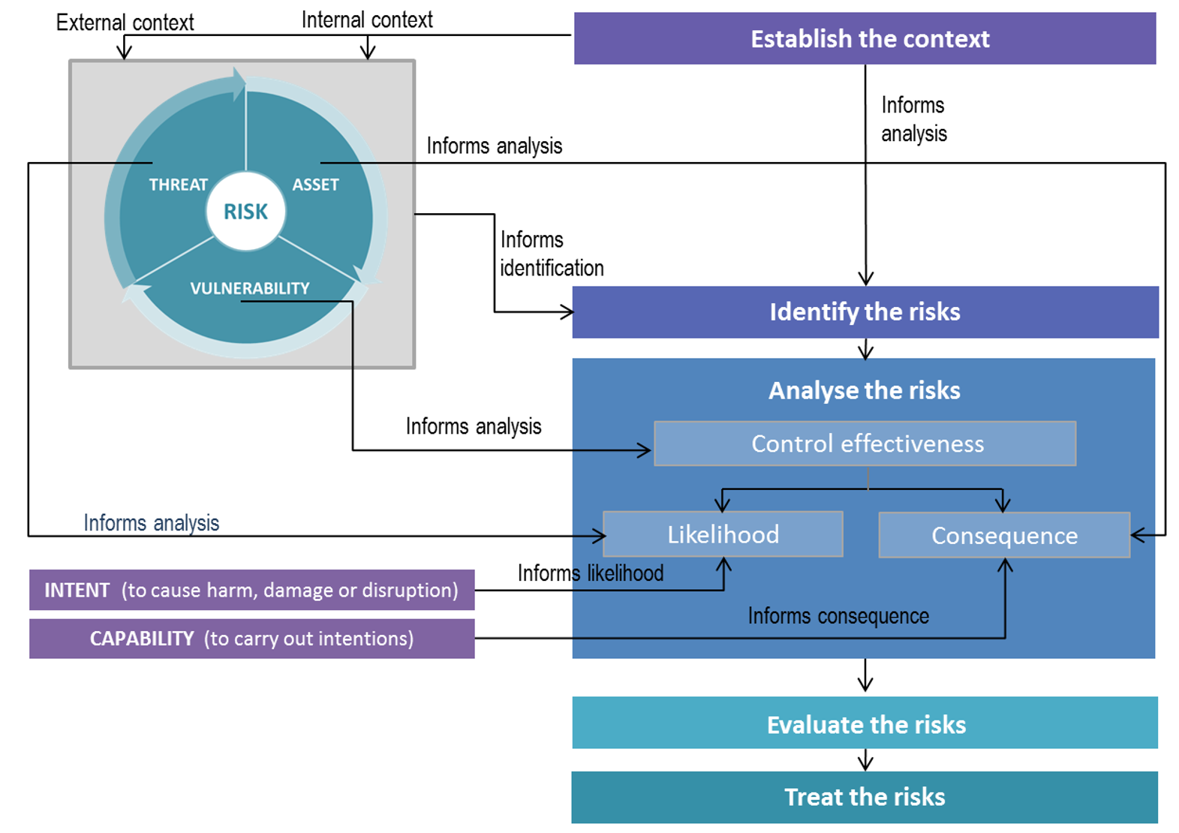
ISO31000 Process

Slide 11
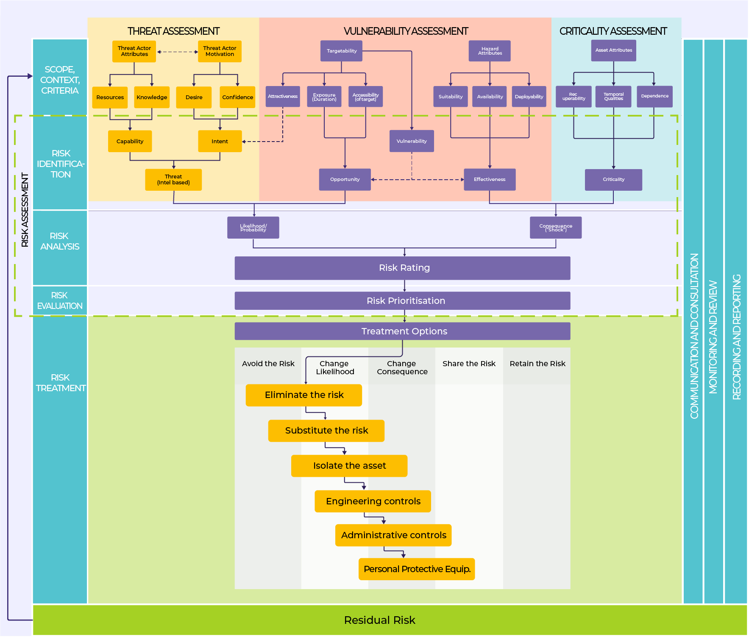
SRMBOK Figure 11.3

Slide 12
Key Elements

Slide 13
Swiss Cheese

Slide 14
Threat Pathway
CONTROLS
CONTROLS
Threat
Intent
Capability
Vulnerability
Asset
Exposure
Criticality
Consequence
Objectives

Slide 16
CARVER Describing a Vulnerability
Criticality – measure of the impacts of an attack
Accessibility – ability to access the target
Recuperability – ability of system to recover from an attack
Vulnerability – ease of accomplishing attack
Effect – amount of direct loss from an attack
Recognizability – ease of identifying target

Slide 17
CAVE Describing a Vulnerability
Cause – what are the immediate and root causes?
Asset – what is the resource or asset that could be vulnerable?
Vector – what specifically would be the attack vector(s)?
Event – what would the attacker use against the vulnerability?

Slide 18
CAVE My neighbour’s house is easy to break into
Cause
immediate cause: night latches are rubbish security
root cause: lack of knowledge about deadlocks
Asset – contents of his house
Vector – doors without deadlocks
Event – burglars can open the front door with a credit card
My neighbours front door (Vector) would be easily opened with a credit card (Event) and his bright and shiny stuff (Asset) stolen as the door is fitted with a night latch (Immediate Cause) because my neighbours don’t realize how deadlocks work (Root Cause).

Slide 19
CAVE My boss has no clue just how vulnerable our IP is!
Cause
Immediate cause: email is widely used by everyone in the business
underlying or root cause: lack of training
Asset – our intellectual property
Vector – human/email
Event – phishing attack
The organization is vulnerable to compromise of intellectual property because staff rely on email but are not trained to identify and manage phishing attacks.

Slide 20
CAVE List your: - assets - possible events - attack vectors (red team, attack tree, etc) - causes
CAUSE | ASSET | VECTOR | EVENT
Immediate causes: - Human error - Legacy software - Maintenance Root causes: - Training - Leadership - Resourcing - Supervision - Work tempo | Property | - Factory gate - Delivery | - Arson - Theft
 | Information | - Email - Internet - USB | - Hacking - Phishing - Malware
 | People | Addictions Remote travel | - Blackmail - Assault
 | Economic | - Inventory - Debt | - Theft - Foreclosure
 | Reputation | - Social media - Newspapers = Television - Political inquiry | - Trolling - Press release - Industrial accident

Slide 21
CAUSES
CAUSES | ASSETS | VECTOR | EVENT
Legacy Software (resources) | Information (patents) | Email Web browsing | Phishing Hacking
Legacy operating system on R&D server (due to) Underinvestment in updating software systems | Data about vaccines in development | Staff rely on email to swap information about new developments in vaccine research | Supplier of the legacy software stopped providing security patches several years ago, leaving the system vulnerable to modern malware
Vaccine research is vulnerable to phishing or hacking attacks because the R&D network is running unsupported operating system software, and users access the internet and manage emails on this network.

Slide 22
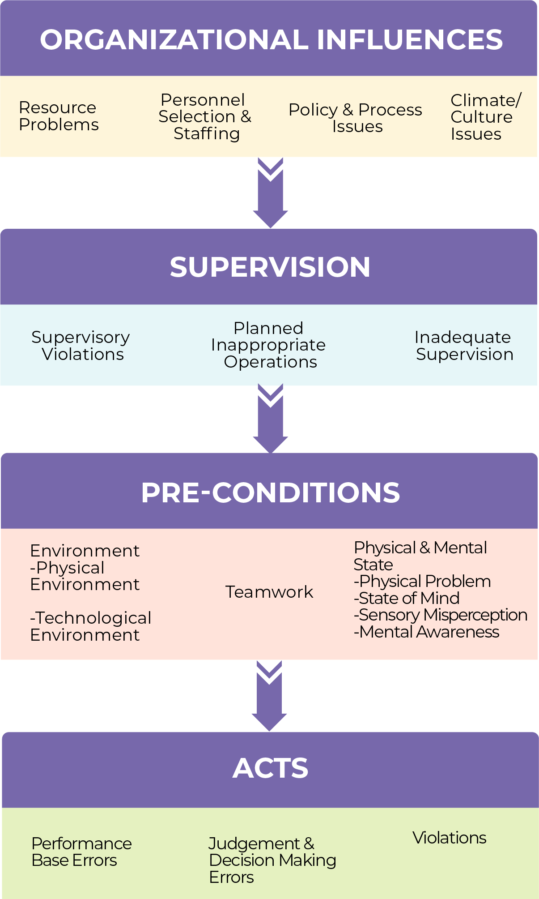
CAUSES
Human Factors Analysis Classification System
(HFACS)
Root Causes
Immediate Causes

Slide 23
REVSCO Integrating a Vulnerability into a Risk Statement
Loss of production inventory (RESOURCE) due to phishing attack (EVENT) by extortionists (SOURCE) against legacy operating system (VULNERABILITY) on the production server causing downtime (CONSEQUENCE) with loss of profits (OBJECTIVES).

Slide 24
What is a Control?

Slide 25
Controls (Apple™ Dictionary)
(noun)
the power to influence or direct people's behavior or the course of events
the restriction of an activity, tendency, or phenomenon: pest control
a means of limiting or regulating something
the base from which a system or activity is directed

Slide 26
Control (SRMBOK)
﻿ ﻿Process, policy, device, or other action that acts to minimize negative risk or enhance positive opportunities.
A process, exercised by an entity’s board of directors, management, and other personnel, which is designed to provide reasonable assurance regarding the achievement of objectives.
Controls include all existing … systems, procedures, physical measures, and so on to mitigate risk.
Notes:
They are known as likelihood controls when addressing likelihood management (left-hand side of bow-tie) and consequence controls when addressing consequence management (right-hand side of bow-tie).
Countermeasures are a subset of controls that include only those controls that mitigate adverse consequences.
Controls may be used to refer to existing or proposed risk treatment measures.

Slide 27
Three Criteria
Are the controls robust and documented?
What assurance do we have that they are being applied and staff are competent?
Is there an audit or self-assessment program to monitor the application of controls?

Slide 28
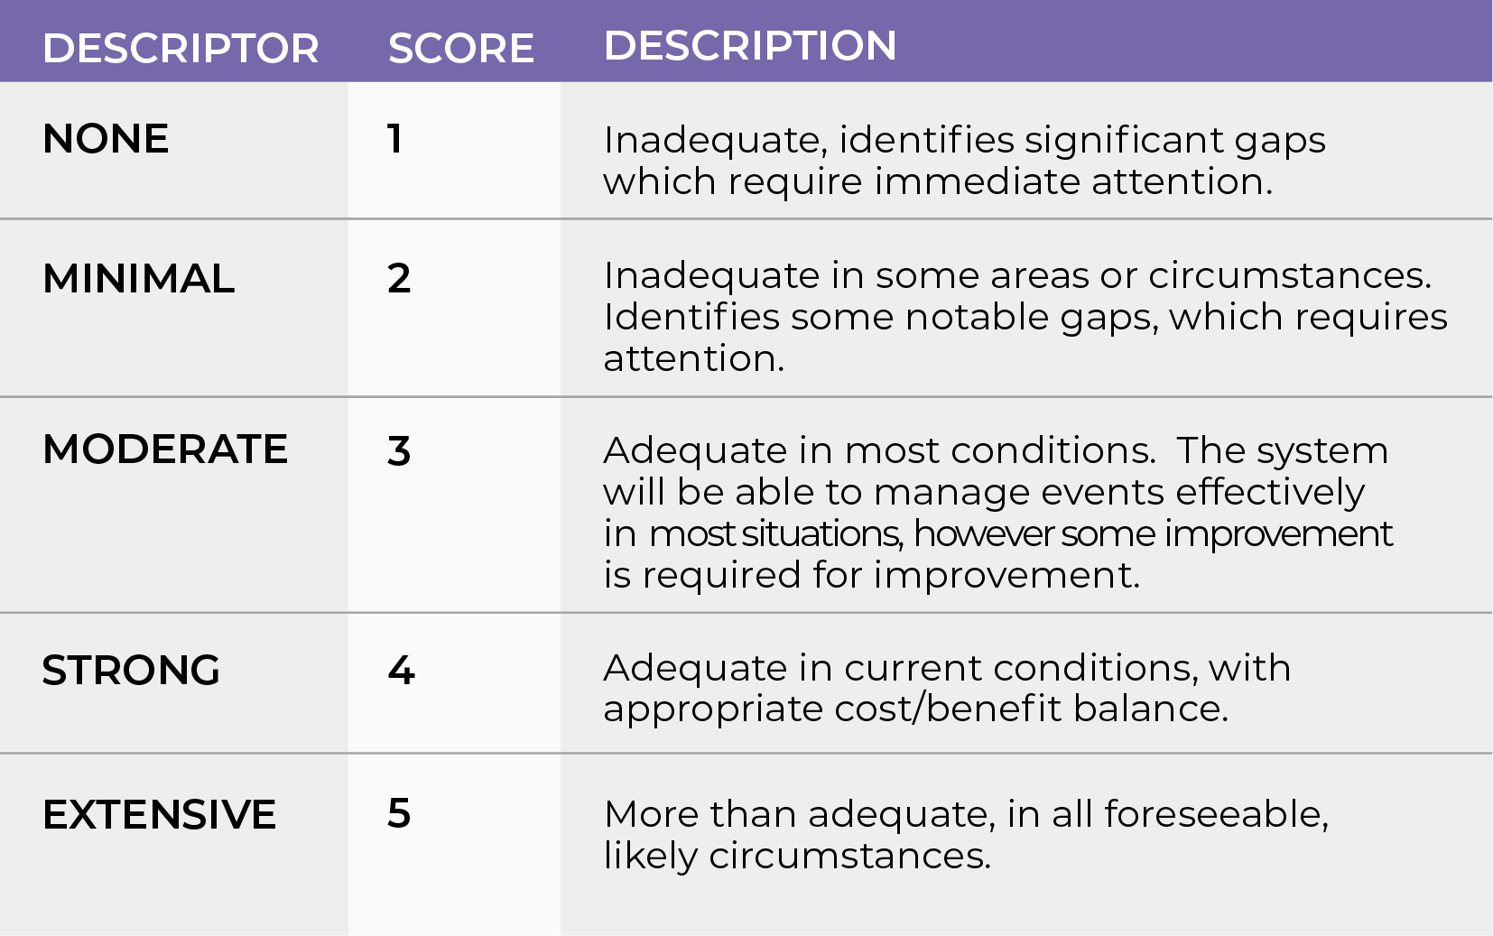
Effectiveness of Controls
Goldilocks effect
Too little
Too much
Just right

Slide 29
Three Criteria For Controls
Effective
Low maintenance
Low cost
You get to choose any two.

Slide 30
C5-PAC Describing a Control
Category – the high-level description
Control ID – document number or unique identifier?
Condition – how effective or well implemented is the control?
Criteria – what criteria are you assessing it against?
Credibility – does it adequately and appropriately address an identified and well-analyzed root cause?
Policy – how robust is the legislation, documentation, procedure?
Assurance – how well is it implemented, trained, & promulgated?
Compliance – what evidence (eg. Audits) prove it’s being applied?

Slide 31
Example Describing a Control
Category – Software maintenance and change procedure.
Control ID – Document Control number XYZ-203 JAN20
Condition – The assessors found that the procedure is only applied in an ad hoc fashion.
Criteria – The Australian Government Information Security Manual (ISM) outlines a cyber security framework that requires cyber security practices to be documented and applied consistently.
Credibility – If executed correctly, the procedure reflects appropriate security measures to mitigate identified vulnerabilities.
Policy – STRONG (4) The procedure is sound and reflects appropriate methods.
Assurance – MINIMAL (2) Staff are not trained in use of the procedure and the IT department is not adequately resourced.
Compliance – NONE (1) No evidence of audits or compliance checks were evident.

Slide 32
Example Describing a Control
The assessors found that the software maintenance and change procedure (document XYZ-203, JAN20) reflects appropriate security measures to mitigate identified vulnerabilities but is inconsistently applied.
Best practice guidelines such as the Australian Government Information Security Manual (ISM) require that cyber security practices are documented and applied consistently.
The procedure is sound and reflects appropriate methods but the IT security team is inadequately resourced and poorly trained in use of the procedure. Furthermore, no evidence of audits, inspections, or compliance checks were evident.

Slide 33
Key Elements

Slide 34
Threat Pathway (aka Causal Chain)
Threat
Intent
Capability
Vulnerability
Asset
Exposure
Criticality
Consequence
Objectives

Slide 35
Free stuff
A guidance sheet to documenting vulnerabilities and controls
Copy of this presentation
Free PDF copy of SRMAM
Free subscription to SECTARA

Slide 36
Putting it all together

